Slide 1
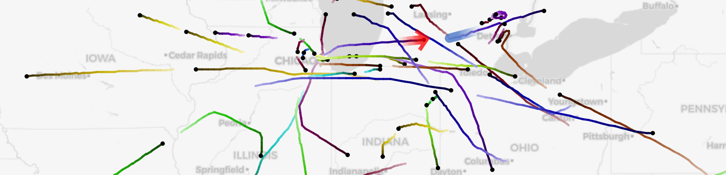
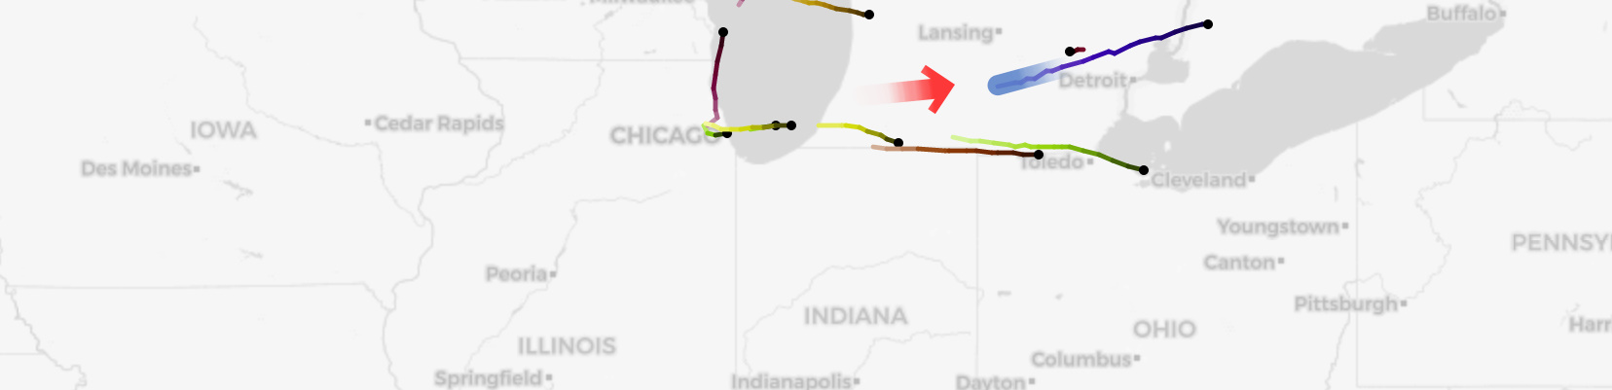
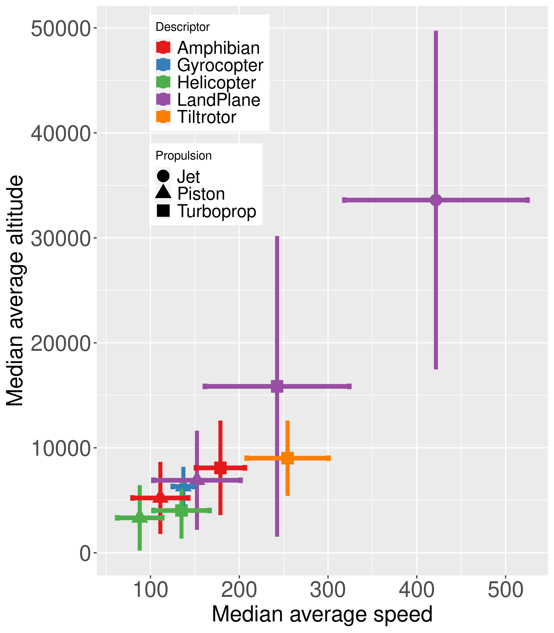
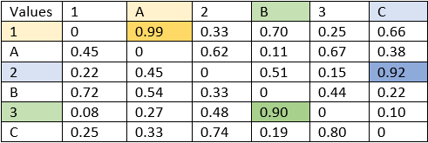
Flight Trajectory Stitching
Bryce Castle, Sean Lee,
​Tanay Athreya, Christopher Ban,
Kabir Batra, Damian Cantu,
Joseph Luo, Yazan Mahmoud
Introduction & Definitions
[1]: Fragmentation of four flights,
“start” pieces are indexed while “end”
pieces are labeled spreadsheet-style.
Given fragments of a flight, the goal is to reassemble flight fragments back together (to complete the motion path) using features of the flight fragments since fragments from the same flight should share similar feature values.
Flights might be broken by:
Individuals tampering with transponder data stream
Data collectors are sparse in some geographical locations
Loss of electrical power and location reporting ability
Trajectory: ordered set of time & position points that define a flight
Alt: shorthand for altitude (reported in feet)
Feature: a value that summarizes a set of points (ex: average alt)
Transponder: aircraft device that sends position data
B
[2]: Our process diagram
1
“start” pieces
“end” pieces
2
F
6
AH
34
A
[3] All flight pieces before culling step
1. Culling
2. Features
3. Normalization
Why? Wanted to narrow down potential endpoints for flights before using features to eliminate obvious unrealistic matches & efficiency reasons
How? Implemented 3 culling approaches:
  time based (going backwards in time)
  speed based (flights that pass threshold of mach-1)
  ascent/descent rate based (flights that climb or descend faster than 4000 ft/min)
Results:
Time: 8.66% match-space reduction
Speed: 78.16% match-space reduction
Ascent/Descent: 9.62% match-space reduction
Why?​ We use these features to compare the similarity of flight tracks. The assumption is that flight tracks with similar features are likely to be the same flight.
​
Top 5 Features: ​
Distance Between
Fragment Endpoints
Climb/Descent rate
Termination Speed
Termination Altitude
Maximum Speed
How? ​Features are fed into
classification and matching.
Why? We wanted to level the playing field of all the features, so our weighting algorithm doesn’t bias towards certain features because their domain is much larger than another feature’s domain.
How? We decided to use
maximum normalization
which would divide the
feature matrix by the
max value of the matrix
to bound the matrix
between 0 and 1.
[6] Feature value ranges
[5] Features between pieces
Feature | Value Range
Term Alt | [0, 14000]
Heading | [0, 180]
Max Speed | [0, 383]
Distance | [0, 5100]
Climb/Desc | [0, 13010]
Loiter Ratio | [0, 38]
[4] Remaining potential matches after culling step
Climb/Descent
rate
Termination Alt
Distance Between
4. Classify
5. Weights
6. Matching/Scoring
Conclusion
Why? Classify flight tracks
into categories by ICAO code,
reducing matching space and
allowing stitching algorithms
to run more efficiently.
How? Characterize categories
by generating bounding
statistics for each, this allows
for passing classified flights
to stitching algorithm.
Results: Allowed for a 66%
reduction in matching space.
What? Scale similarity values by a weight before adding the features together.
Why? Give certain features more priority when matching to increase matching accuracy; can also be used to determine low value features.
How? Differential Evolution global optimization function; weights sum to 1; goal to maximize matching accuracy
Why? Evaluate if process is correctly pairing matches.
How? Multiply the weighted and normalized feature & culling matrices to get a resulting matrix of probabilities of track pairings. Search for highest probability in matrix, match track indices, produce pairing, remove indices from matrix and repeat. Test on known ground truth.
Conclusion: We can correctly pair 79% of 1000 test flights that have been split in two after randomly removing 5% of their path. Additionally, as we remove more from the ground truth data, the score drops due to our reliance on distances between pieces.
Future Work: Creation of
additional features and
classification algorithms.
Acknowledgements:
Thanks to Data Mine staff
and our mentors, Dr. Andy
Wilson & Dr. Katrina Ward
for their guidance and support throughout this year.
[7] Scatterplot of class. stats
[10] % removed vs score
[9] Finding track pairings in final resulting matrix
Rows: Start Tracks
Cols: End Tracks
Pairings:
(1,A), (2,C), (3,B)
[8] set of computed feature weights
Feature | Term Alt | Term Speed | Max Speed | Distance Between | Climb Descent
Weights | 0.085 | 0.101 | 0.035 | 0.535 | 0.244

